Slide 1



Infibeam Business Intelligence Implementation
26 April 2017
Deeksha, Jake, Mohammed, Pratyush, & Sanchit

Slide 2
Our Organization
“Infibeam e-Commerce” is an online electronic e-commerce website founded in January 2017, that focuses on selling Mobile Phones, Smart Devices.
Organization Backed-up by Google ventures, co-founded by Pratyush Kulwal, Sanchit Mehra, Deeksha Paliwal, Jake Fabrizio and Farees Patel.
Notes:
Jake

Slide 3
Business Intelligence Group
One of the critical business unit of the organization, which operates at an intersection of ecommerce, marketing and business strategy.
Supports all the operational and strategy reporting for the organization
We create MAGIC !
Notes:
Jake

Slide 4
Why Business Intelligence is Needed
To achieve competitive advantage against all competitors.
To know the customer pain-points and resolve them in timely manner
To create a business strategy based on current and future market trends for new products
To support daily operations and to be as lean as possible
Notes:
Jake

Slide 5

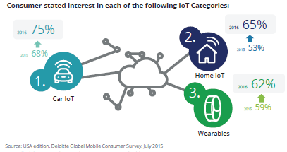
Hypothesis
According to Gartner and Deloitte reports, the adoption of IoT (Internet of Things), smart devices and sensor based devices is going to increase exponentially
Notes:
Pratyush

Slide 6
Business Questions – Strategy Level
Who will be the target age demographic for adoption of IoT
What should be the marketing strategy for targeting these customers
What is current cell-phone adoption and how much a consumer is willing to spend for latest IoT based device
Notes:
Pratyush

Slide 7
How did we answer these questions ?
Identified and collected the sales data and created a fact to answer the above questions
Notes:
Pratyush

Slide 8
Lets walk through the whole process (Sales Fact)
Database Server used : SQL Server
ETL : Microsoft SSIS
Analysis: Microsoft SSAS and Tableau Server
Notes:
Pratyush

Slide 9
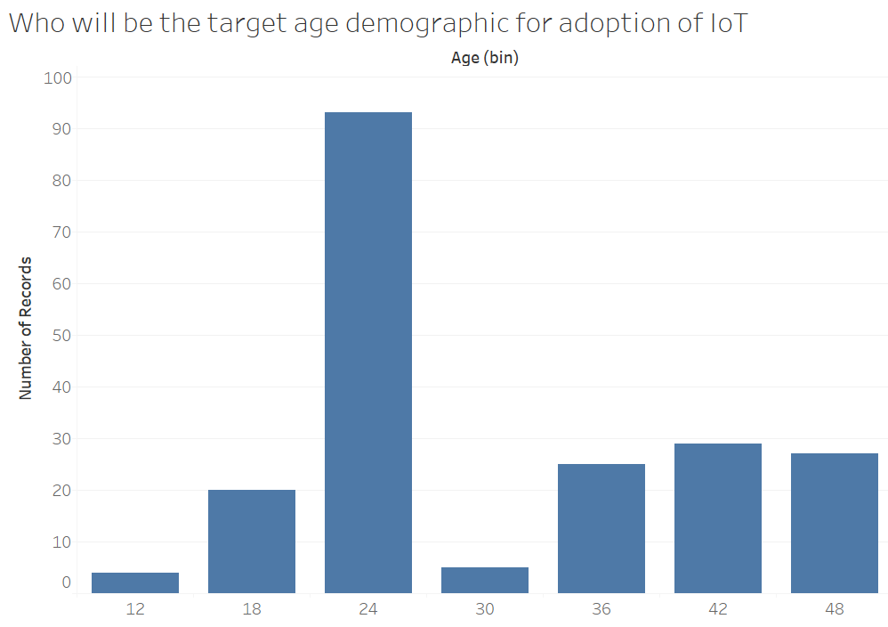
Target Demographic
Notes:
Pratyush

Slide 10
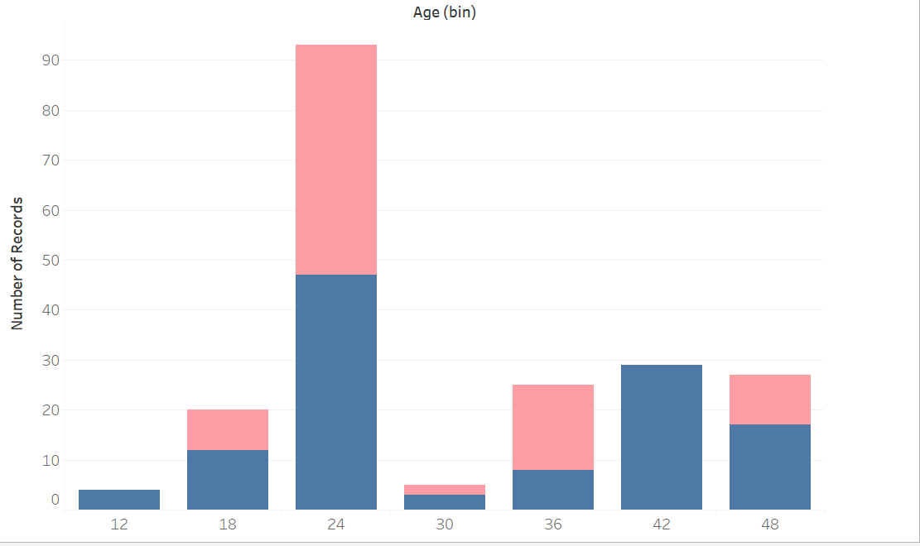
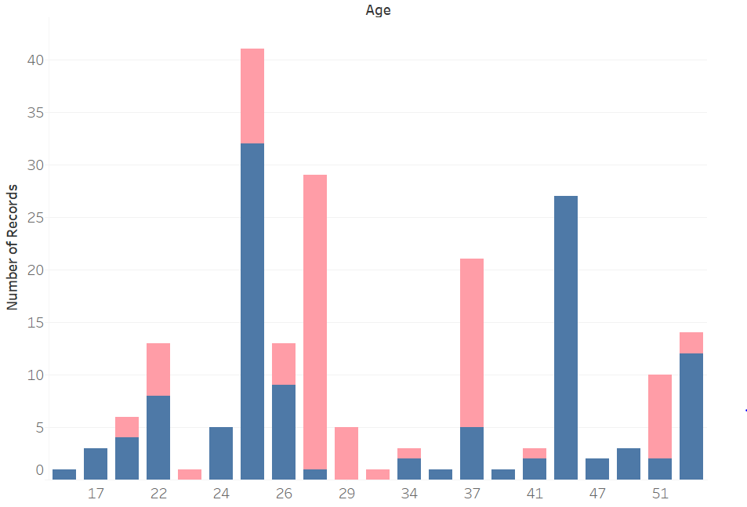

Target Demographic (Gender-based)
25-37 year old age demographic is being identified as early technology adopters
Females in that demographic purchase more as compared to men
Notes:
Pratyush

Slide 11
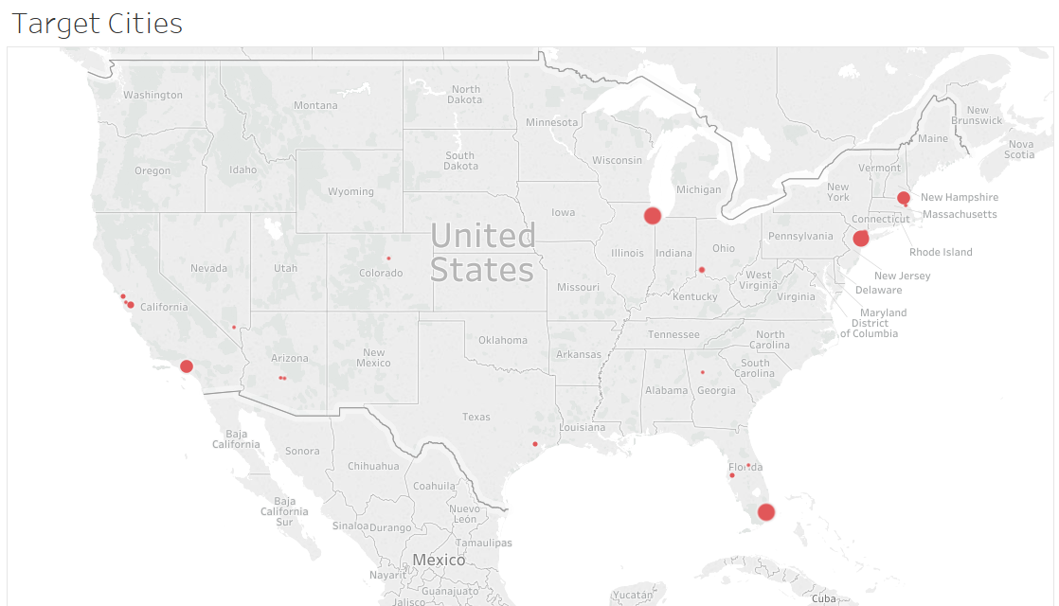
Target Cities for Marketing
We Found that coastal areas are early adopters to new technology products
Notes:
Pratyush

Slide 12
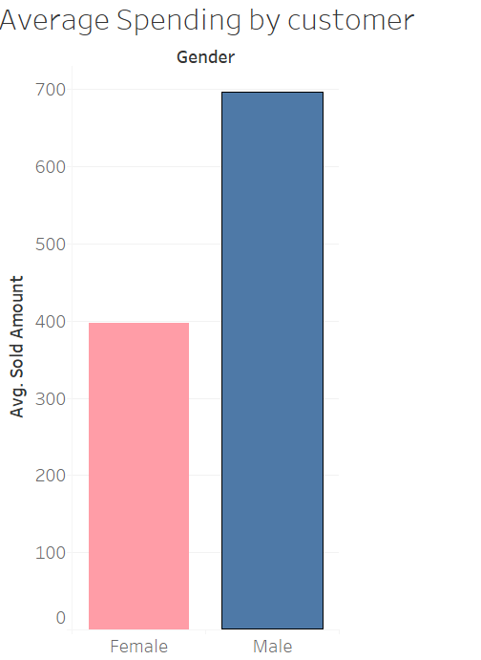
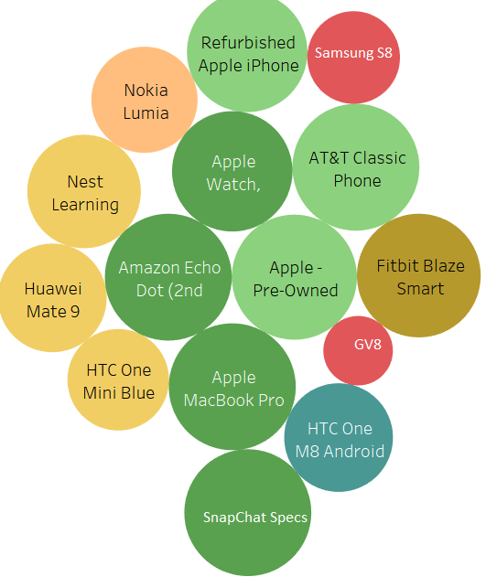
We Found that Males are willing to spend more money on mobile and smart products as compared to Females.
Thereby, from product launch point – a new smart product’s price must be in $400-$500 range if it’s targeted at Female demographic
We also found that NLP technology and AR/VR technology is going to be one of the fastest adopted technologies
Notes:
Pratyush

Slide 13
Business Questions - Operational Level
Sales of a product – Categorized by Each State
Notes:
Fareez

Slide 14
Business Questions - Operational Level
To find out verified customers who give the product rating
Need of a KPI, which could enable customer satisfaction teams to reach out to verified dissatisfied customers
Notes:
Fareez

Slide 15
Business Questions - Operational Level
To find out verified customers who give the product rating
Notes:
Fareez

